Slide 1

Abstract Expressionism
and
Color Field Painting
Line and Gesture

Slide 2
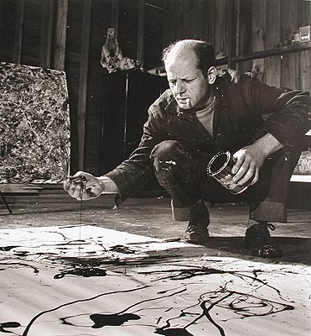
Jackson Pollock
Notes:
What we see here is the painting method Pollock became famous for. Instead of painting on an easel, he laid his massive canvases down on the studio floor and dripped paint directly onto the surface. Let's take a little time and trace how he arrived at this method of working.

Slide 3
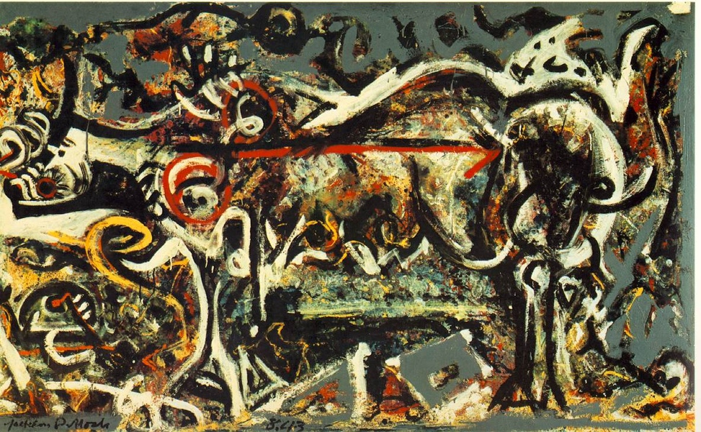
Notes:
In this piece called "She Wolf", Pollock hasn't abandoned the figure yet, but much of his later style is already present. For one thing we have an "all over" composition, that is to say, the subject fills the entire canvas, to the point where it is almost all figure and no ground. The wolf's body stretches to fill every corner. Also we see this expressive brushstroke that Pollock became known for. One interesting thing to note in this piece is how the flat grey background has been painted on top of the rest of the painting. Usually a background is used to create depth in the painting, but here is does the opposite, forcing everything onto the top layer of the canvas.

Slide 4
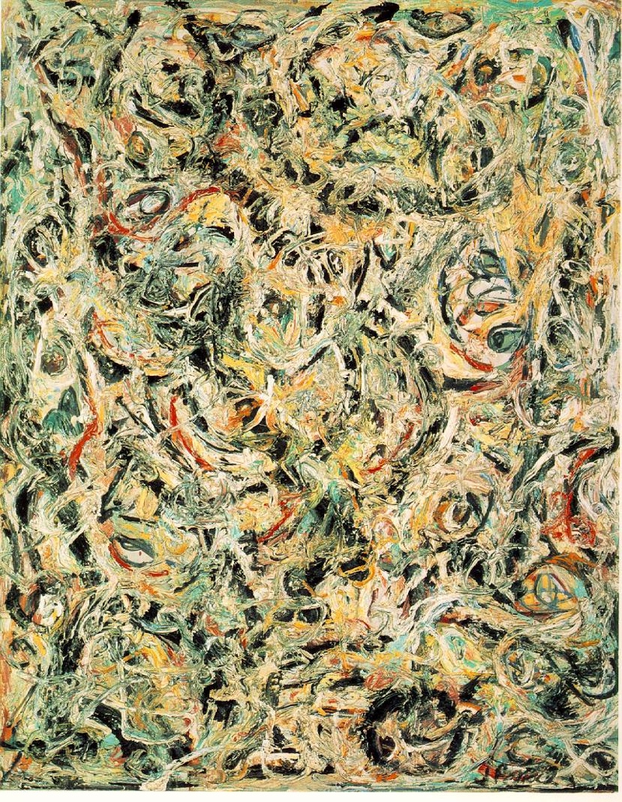
Notes:
In this piece he has abandoned the figure entirely, and just concentrated on the expressive brushstroke. Examining the this paint on the canvas, we see it has still been painted in a traditional manner, propped on and easel and painted with paint brushes.

Slide 5
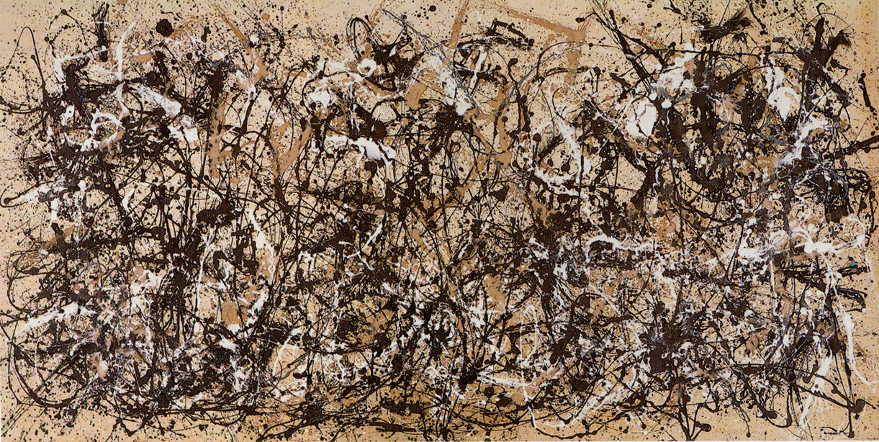
Notes:
Now we see his mature style, one of a series he made for his solo show in 1950. The paint has been thinned to a liquid and dripped onto the canvas which was laying on the floor. There is a direct relationship between the gesture of his arm and the movements within the dripped paint.

Slide 6
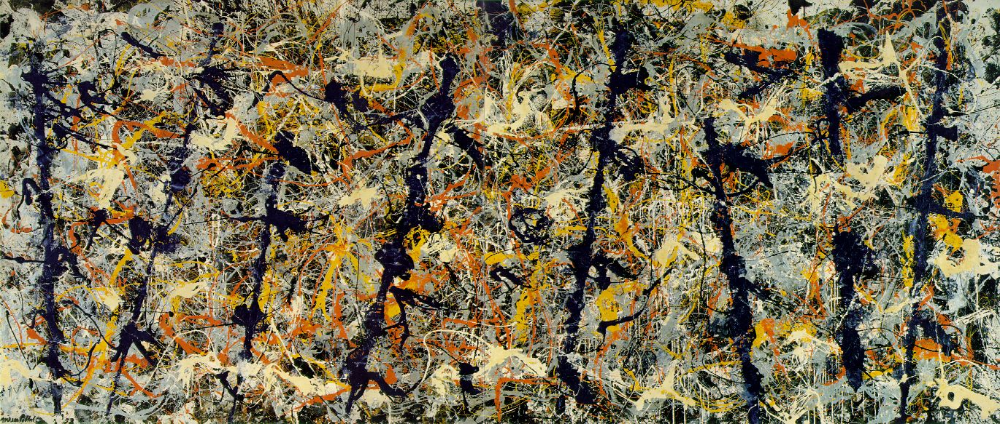
Notes:
To appreciate these pieces, you must really see them in person. Study them from a distance, and then slowly get closer to examine the details. I'm going to try to fake this experience now by zooming into this canvas over the next four slides. Notice again the all over composition, as we zoom in and crop the canvas, the composition itself isn't affected, but smaller and smaller details emerge from the painted surface.

Slide 7
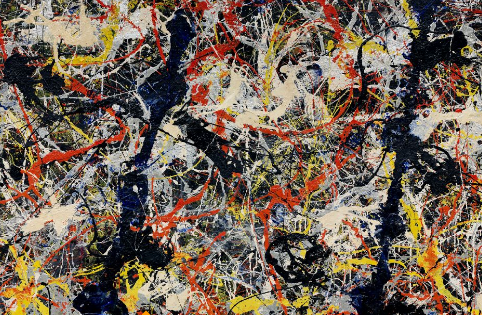

Slide 8
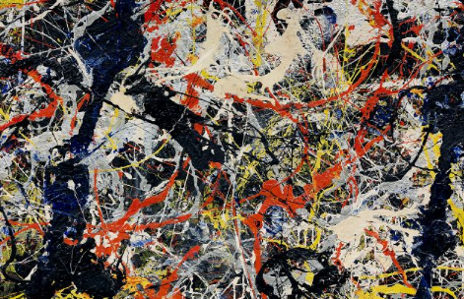

Slide 9
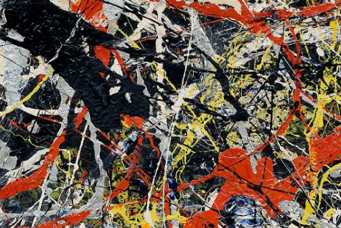

Slide 10
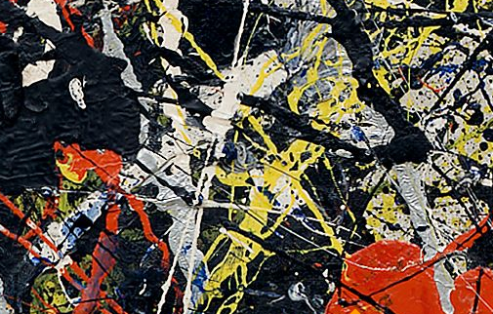

Slide 11
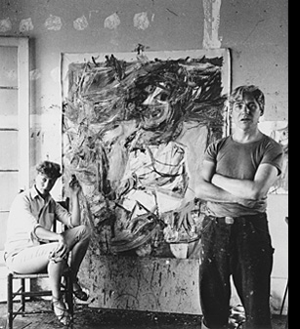
Willem De Kooning
Notes:
Willem de Kooning came to New York from the Netherlands, he was trained in traditional art techniques and shared many of them with the other Abstract Expressionists. Even though he was one of the Abstract Expressionst much of his work remains directly or indirectly figurative.

Slide 12
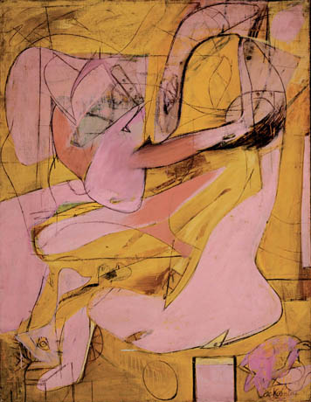
Notes:
In this piece titled "Pink Angels" we again see biomorphic shapes similar to Gorky's. The title gives us a hint as we look at this piece we can make out what seem to be figures painted in pink on the yellow background.

Slide 13
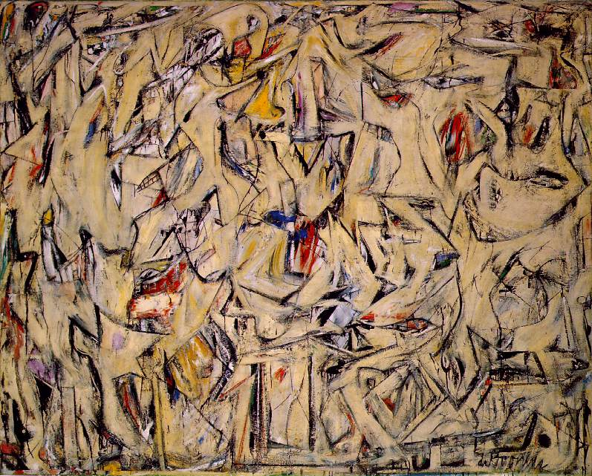
Notes:
This piece titled "Excavation" is a very powerful work that de Kooning painted in 1950, the same year as Pollock's major solo exhibition and it bears many similarities. The all-over composition is similar to Pollock's as are the colors, neutral canvas background with many crossed black gestural strokes. Look into the patterns in this piece and you will see figurative elements such as eyes and mouths, teeth and lips.

Slide 14
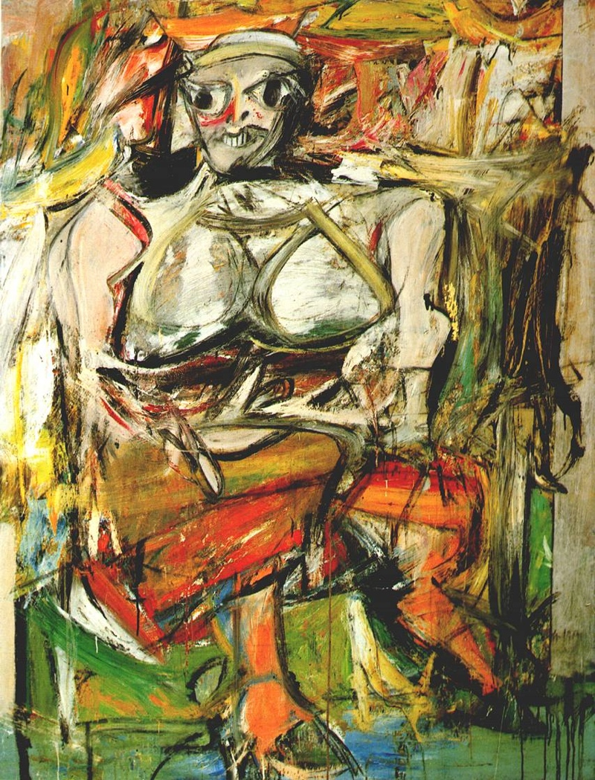
Notes:
De Kooning is perhaps most famous for his woman series which have been both loved and hated. Garish, vulgar depictions of women with frightening faces and very aggressive brushstrokes. De Kooning worked on these canvases over and over again for many years before he decided they were finished. Examine the brushstrokes layered upon each other, worked and reworked. Now compare the background in this painting...

Slide 15
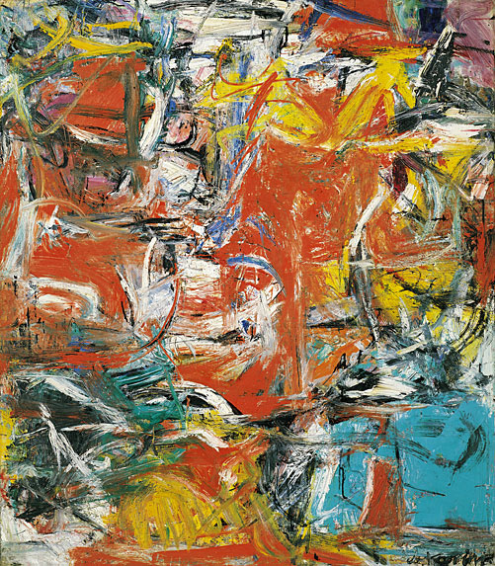
Notes:
...to this composition without a figure. Notice the similarity in style, the black smeared through the bright colors muddying them. The aggressive strokes that have been worked and reworked multiple times.

Slide 16
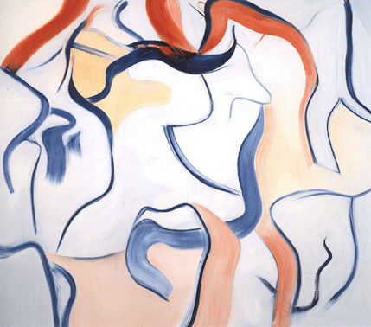
Notes:
Here is an example of a late painting by de Kooning from the 1980s. His last works return to a soothing and lyrical line with little trace of the aggressive brushstrokes that we see forming in the woman series.

Slide 17
Images:
Jackson Pollock
She-Wolf, 1943
Eyes in the Heat, 1946
Autumn Rhythm (Number 30), 1950
Blue Poles, 1952
Willem De Kooning
Pink Angels, c.1945
Excavation, 1950
Woman I, 1950-52
Composition, 1955
untitled painting, 1980’s
Notes:
Jackson Pollock She-Wolf, 1943 Eyes in the Heat, 1946 Autumn Rhythm (Number 30), 1950 Blue Poles, 1952Willem De Kooning Pink Angels, c.1945 Excavation, 1950 Woman I, 1950-52 Composition, 1955 untitled painting, 1980’s

